Slide 1








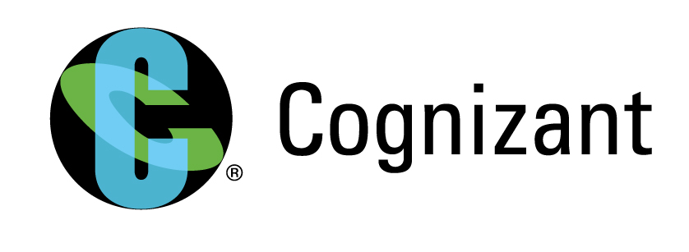
MetLife RDM (Reference Data Management)
In RDM we import the records into the RDM platform and take an extract of the inserted records in form of files to be used as a reference data.
Key Highlights
Source
Received files from different applications like UDS, UIS, TAM DPA, Integration,SFDC etc.
Different files from 6 Source System
(UDS, UIS,TAM, etc.)
2 Team members
Solution Highlights
The team first process the files in the Informatica Data quality tool and get it loaded to the Base object table in RDM according to the Data model specified.
Records get inserted into the BO table using IDQ mappings or by inserting it manually through IDD.
Once the records are in BO,it is available for users to see ,modify and delete according to the privileges assigned.
For the extraction of the files, package is created in certain defined format in RDM which is read through IDQ and is written in an output file.
Files are moved from IDQ cloud server to the local premises server through sftp scripts.
In the local folder, split the file in order to get the files on basis of the Reference Set .
Extracted data to be used as reference data or lookup data in IDQ
The files from different application is processed and loaded into the RDM platform through IDD or IDQ.
Technology Stack: Informatica Reference Data Management, Informatica Data Director, Informatica Analyst, Informatica Developer
12 month engagement
Business Outcome
Once the data is loaded into the RDM platform ,it can be used as Reference data or lookup data to be used by other applications.
Business users gets the golden records and can use those records for further processing.

Slide 2

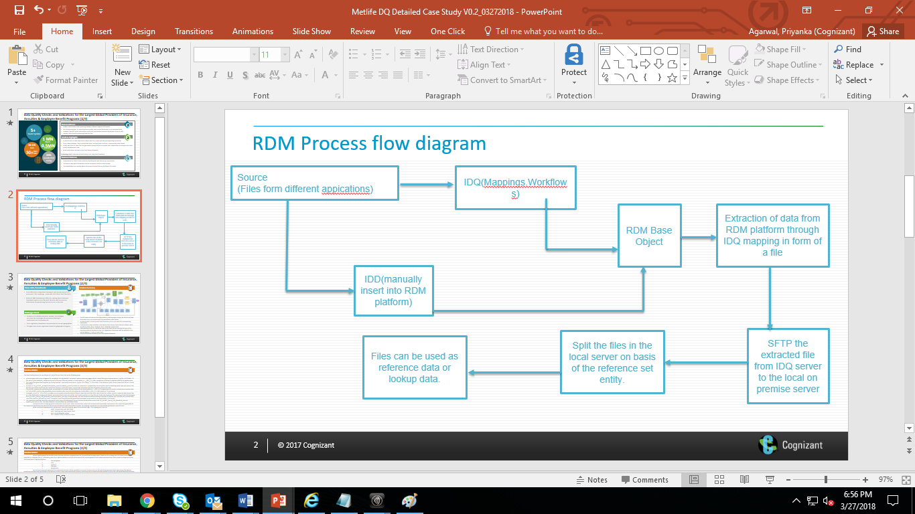



MetLife RDM(Reference Data Management)
Solution Details
Solution Architecture
After extracting the file from one server, used sftp scripts to transfer the file from one server to another.
Some mechanical task of loading the records in Base Object table are automated though IDQ mappings and workflows which reduced the effort and time.
Value adds/
Investments
Solution Description
The incoming files containing all the records to be inserted in all the business entities like( Reference Set,Reference Set Instance,Code Value,Misc Attrib,Application and Version) is formatted in which IDQ would understand.
Need to run the IDQ workflow in order to insert those records into the Base Object table or can insert the records manually through IDD..
Once the data is in the Base Object table, any business user can view the records according to the roles and privileges assigned.
For the extraction of data, had developed packages in RDM which will be read through IDQ mapping and will be written in an output file.
The extracted file is now in the cloud server, which will be move from the IDQ server to the local premises using the SFTP script.
Once the file is in the local premises,we split the files according to the Reference set.
Challenges Faced
Initially loaded all the records to Base Object manually, then created mappings in order to automate the process.
Great time was invested to develop the automation using IDQ.
Setting up LDAP for authentication was a bit tedious task.
Files transfer from one server to another seemed a bit challenging ,created an unix sftp script to transfer the files.

